Slide 1
Adaptive and Equitable Water Resources Planning Under Uncertainty
Sarah Fletcher, Ben Rachunok
07/12/2021

Slide 2
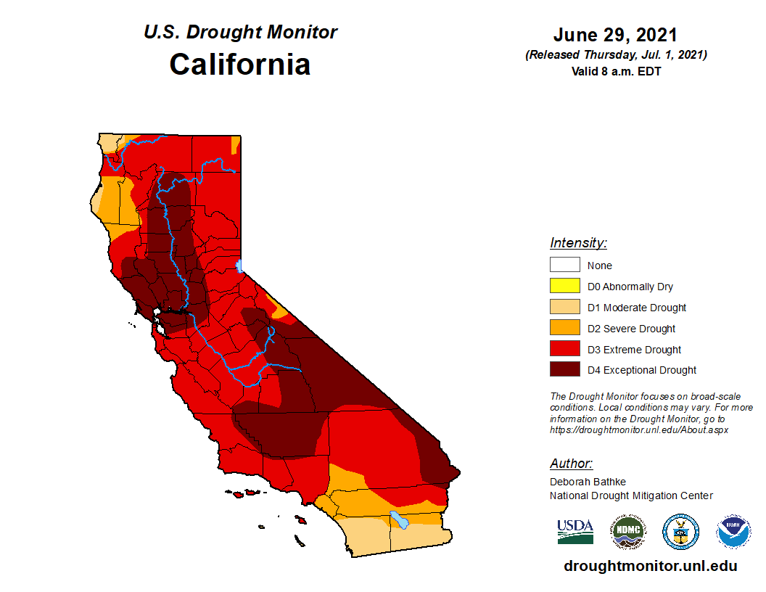
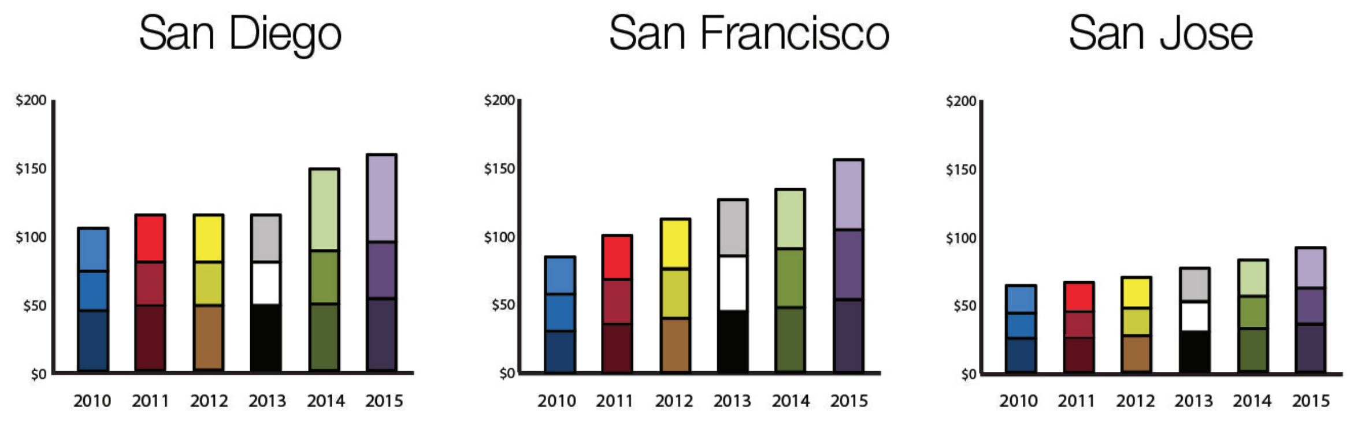
Two ongoing crises in California
Droughts
California continuing to face severe drought conditions
Water Affordability
Water rates rising faster than inflation across the US
In California, over 1,000,000 people lack access to clean, affordable, drinking water
California Drought Monitor
July 2021
Residential Water Rates, 2010-2015
Circle of Blue Water Rate Survey, 2019

Slide 3
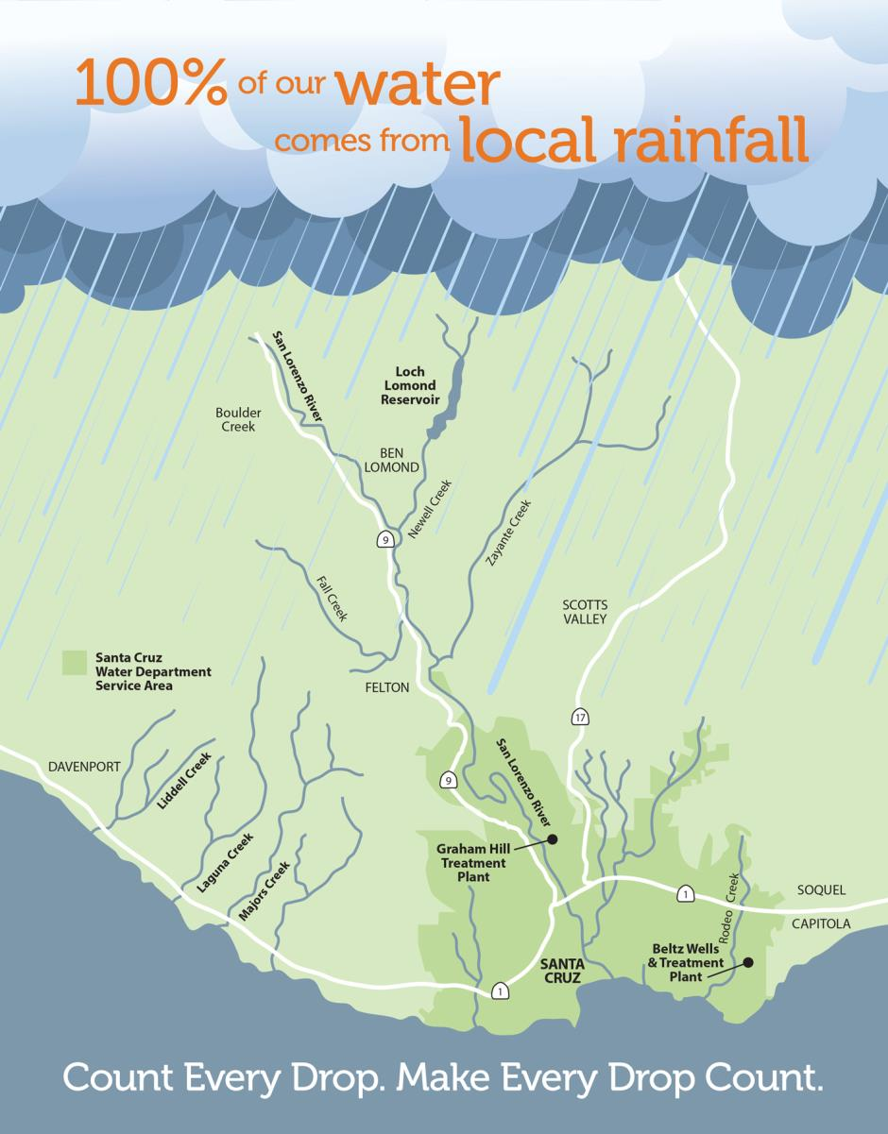
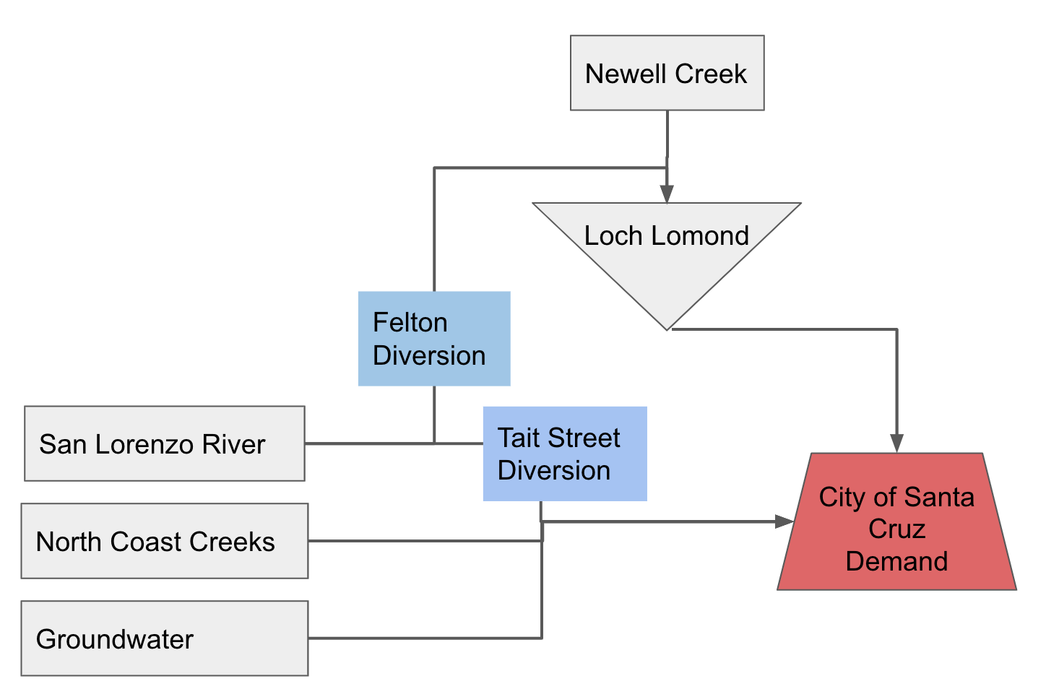
Santa Cruz
Water Affordability
100% local water supply
Limited options for expanding supplies
Sensitive to drought conditions
City of Santa Cruz

Slide 4
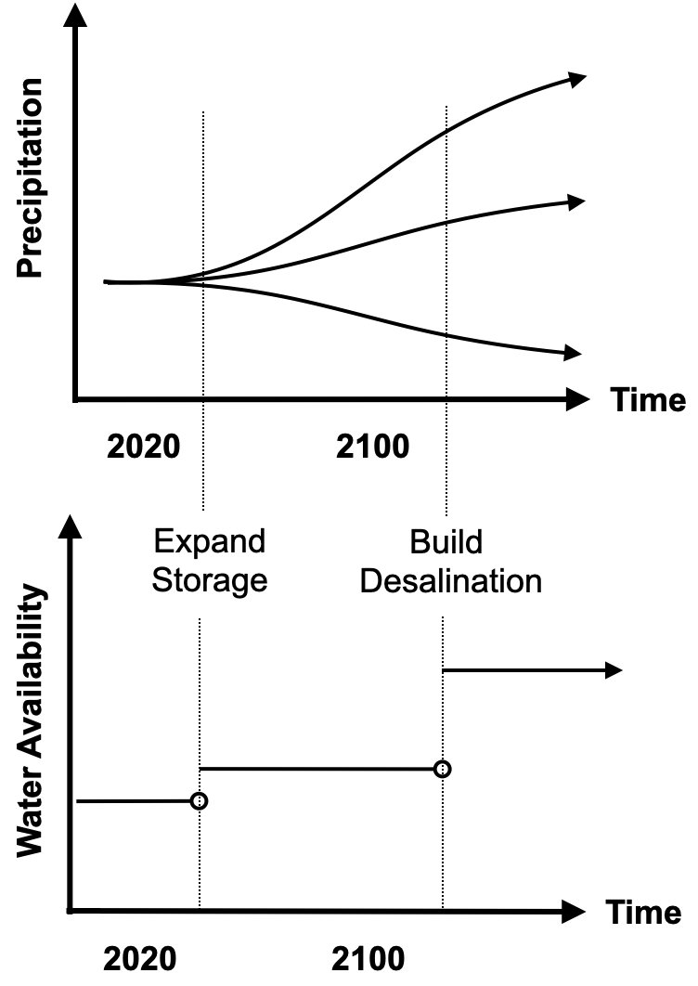
Drivers of affordability
Hydrology
Both changes and future uncertainty
Capital Investment
Improve reliability
Fix aging system
Non-drought climate impacts
Winter storms
Landslides
Fires
Conservation
Utility revenue losses
Surcharges/rate adjustments
Constrained by Prop 218
Water demand behavior

Slide 5
Adaptive and flexible planning under uncertainty
How do we plan for an uncertain future given we learn over time?
What are the decisions which minimize cost and maximize reliability?
How can adaptive and flexible infrastructure options be used to mitigate risk and minimize cost?
Fletcher et al. 2019 Nature Comm.
Fletcher et al. (2017) J. of Water Res. Plan. Man.

Slide 6
The types of decisions we work to inform
Examples
What capacity expansions should we plan given uncertainty in long-term climate impacts?
What short- or long-term adaptation triggers should we use to ensure robustness to climate change?
How do supply portfolios stand up to mild, prolonged droughts vs short, intense droughts?
When should demand management be implemented?
How should reservoir operations be adapted as the climate changes?
Performance metrics: cost, reliability, environmental flows

Slide 7
Santa Barbara

Slide 8
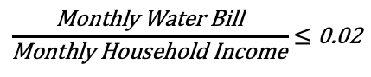
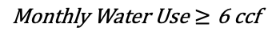
Our Model
Developing metrics that reflect community needs:
Affordability:
$$\frac{\text{Monthly} \text{Water} \text{Bill}}{\text{Monthly} \text{Household} \text{Income}}≤\text{0.02}$$
Access:
$$\text{Monthly} \text{Water} \text{Use}≥\text{6 }\text{ccf}$$

Slide 9
Our Model
Things we evaluate as components of affordability
Household size & income
Rate structures, and increases
Capital investment
Drought surcharges
Water system characteristics
Hydrology & drought
What do we mean when we say affordability?
How much of a household’s income is spent on water

Slide 10
Initial hypotheses related to affordability
Affordability differs from cost
Affordability thresholds limit cost increases
Increase risks for technology lock-in
Conservation challenges due to hardened demand
Adaptive planning can mitigate affordability concerns
Reduces scale of new infrastructure to minimize costs
Spread infrastructure into smaller investments over time
Sequence investments to reduce cost increases

Slide 11
Evaluating paths forward
Testing potential solutions
What capacity do water rates have to support investment without subsidies?
What would state or federal programs have to look like to meet affordability and reliability targets?
Low-income rate assistance programs
What are the attributes required for technological solutions?
Short-term water sourcing vs. permanent investment
What is the potential for demand-side drought mitigation measures?

Slide 12
Partnership model
Goal is to develop long-term, mutually beneficial partnerships
Recognizing constrains e.g. time
Potential benefits to Santa Cruz
Testing potential solutions
Independent source of policy analysis
Bolsters case for state and federal investment
Information Gaps for Stanford
Household affordability quantification
Household-level water use and bills
Contextual Understanding of Santa Cruz’s Water System
Historical water production
Potential water supply alternatives
How non-residential water use changes during droughts
How conservation decisions are made?

Slide 13
Backup Slides

Slide 14
Santa Cruz Water Demand
Focus on household water costs/access
Need to model household-level water use
What contributes to household water use?
Currently considering
Month-to-month changes
Household use as a function of household size
Household use as a function of household income
Demand changes in response to prices signals (price elasticity)
Any conservation

Slide 15
Water Balance For Santa Cruz
Net Reservoir Evaporation
Spillage (if necessary)
Surface Water Sources
Groundwater
Volume of water stored at t
Demand (adjusted)
Environmental outflow
Natural inflow to reservoir
Volume of water stored at t+1

Slide 16
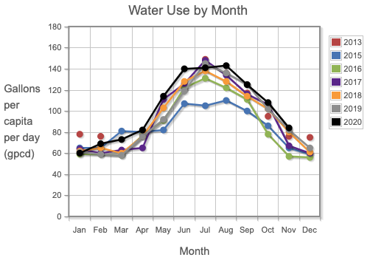
Household water demand
Unit of measure for residential demand is household
Start with median per-person-per-month water consumption in non-drought years
Reported by SWRCB
From: https://pacinst.org/gpcd/table/#

Slide 17
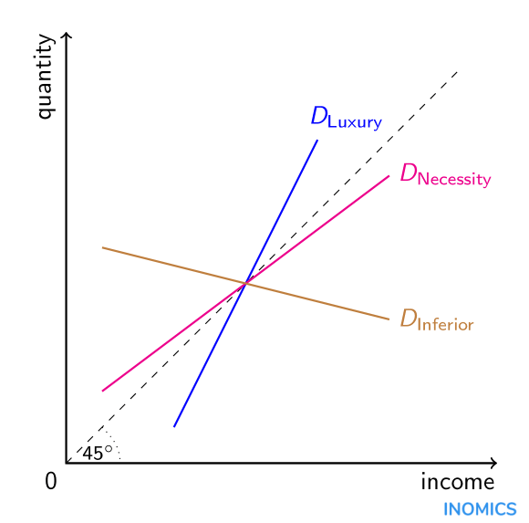
Household water demand
Adjust baseline water use based on household income
Using price elasticity of water demand
“Given a 1% increase in my income, how much more water do I consume?”
Lots of work by our friends in the economics world trying to estimate this value. We use 0.1
Elasticity value is slope of the line

Slide 18
Household water demand
EXAMPLE
Water use for median income: 100G/month
What’s the water use for someone making 150% of median income?
50% increase in income
Change in Income x Income Elasticity = Change in Quantity
50% increase x 0.41 = 20.5% increase in water use
= 120.5 G /month
Elasticity value is slope of the line

Slide 19
Household water demand
Use this to adjust water uses for 16 different income classes:
Household incomes of $7,500/yr all the way to up to $250,000+/yr
Calculate average size of households in each income class
Multiply income-adjusted per-person water use by household size to get a household water use
Elasticity value is slope of the line

